Slide 1
Ecology
The study of the interactions between organisms and their environment

Slide 2
Basic concepts
Ecology is a SCIENCE, not a political movement (e.g. Environmentalism).
Ecologists pose questions and test hypotheses about ecosystems, populations and environments.
Ecological interactions contribute to cycling of nutrients.
Natural selection is driven by ecological interactions between sets of organisms and organisms and their environment.

Slide 3
Branches of Ecology
Scientific study of relationships in the natural world.
Includes:
relationships between organisms and their physical environments (physiological/organismal ecology)
between organisms of the same species (population ecology)
between organisms of different species (community ecology)
between organisms and the fluxes of matter and energy through biological systems (ecosystem ecology).

Slide 4
Biosphere
Biome
Ecosystem
Community
Population
Organism

Slide 5
Climate
What is it?
Factors that affect climate?

Slide 6
Climate
What is it?
Average temperature and precipitation of an area.
Consistent year to year
Factors that affect climate?

Slide 7
Climate
What is it?
Average temperature and precipitation of an area.
Consistent year to year
Factors that affect climate?
Greenhouse effect
Latitude
Ocean currents
Winds

Slide 8
Greenhouse effect

Slide 9
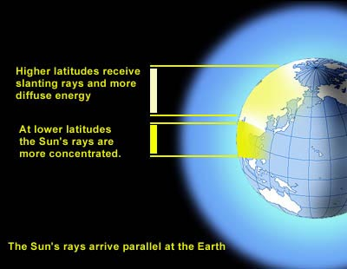
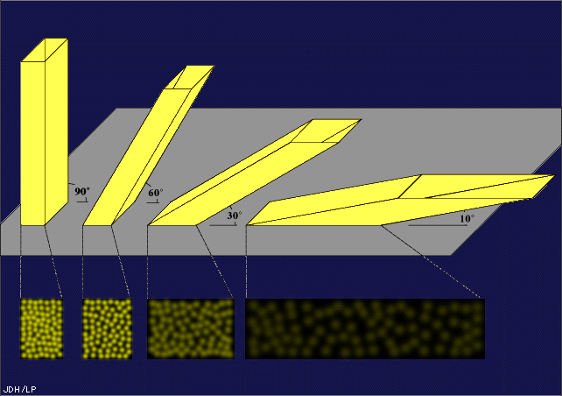

Slide 10
Latitude and sunlight

Slide 11
Ocean currents

Slide 12
Winds

Slide 14
what factors determine the conditions of a biome?
temperature
precipitation
= climate

Slide 15
Components of the Biosphere
Biotic factors –
Abiotic factors –

Slide 16
Components of the Biosphere
Biotic factors – the living organisms
Abiotic factors – the nonliving components:
Light
Water
Nutrients
Soil quality
Topography
Temperature
Etc.

Slide 17
Climate and Flora
Climate (abiotic factors) directly influence flora in a region.
Flora dictate fauna.
Knowing how abiotic factors vary leads to understanding patterns of life on Earth.
A sampling of biomes, biomes and their distribution on Earth.
As you look at the biomes – consider the abiotic factors in each.
Look for Climate Trends.
Consider biotic factors:
Is there an abundance of life or scarcity?
Is the life varied in size/shape or similar in stature?
Additional sources of info: biome, biome overview, mappinglife

Slide 18
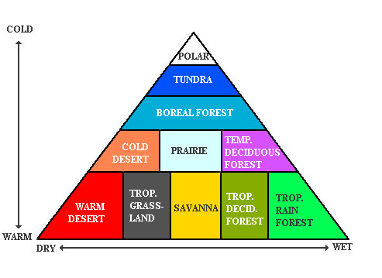

Slide 19
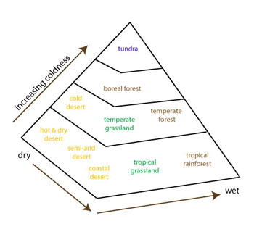

Slide 20
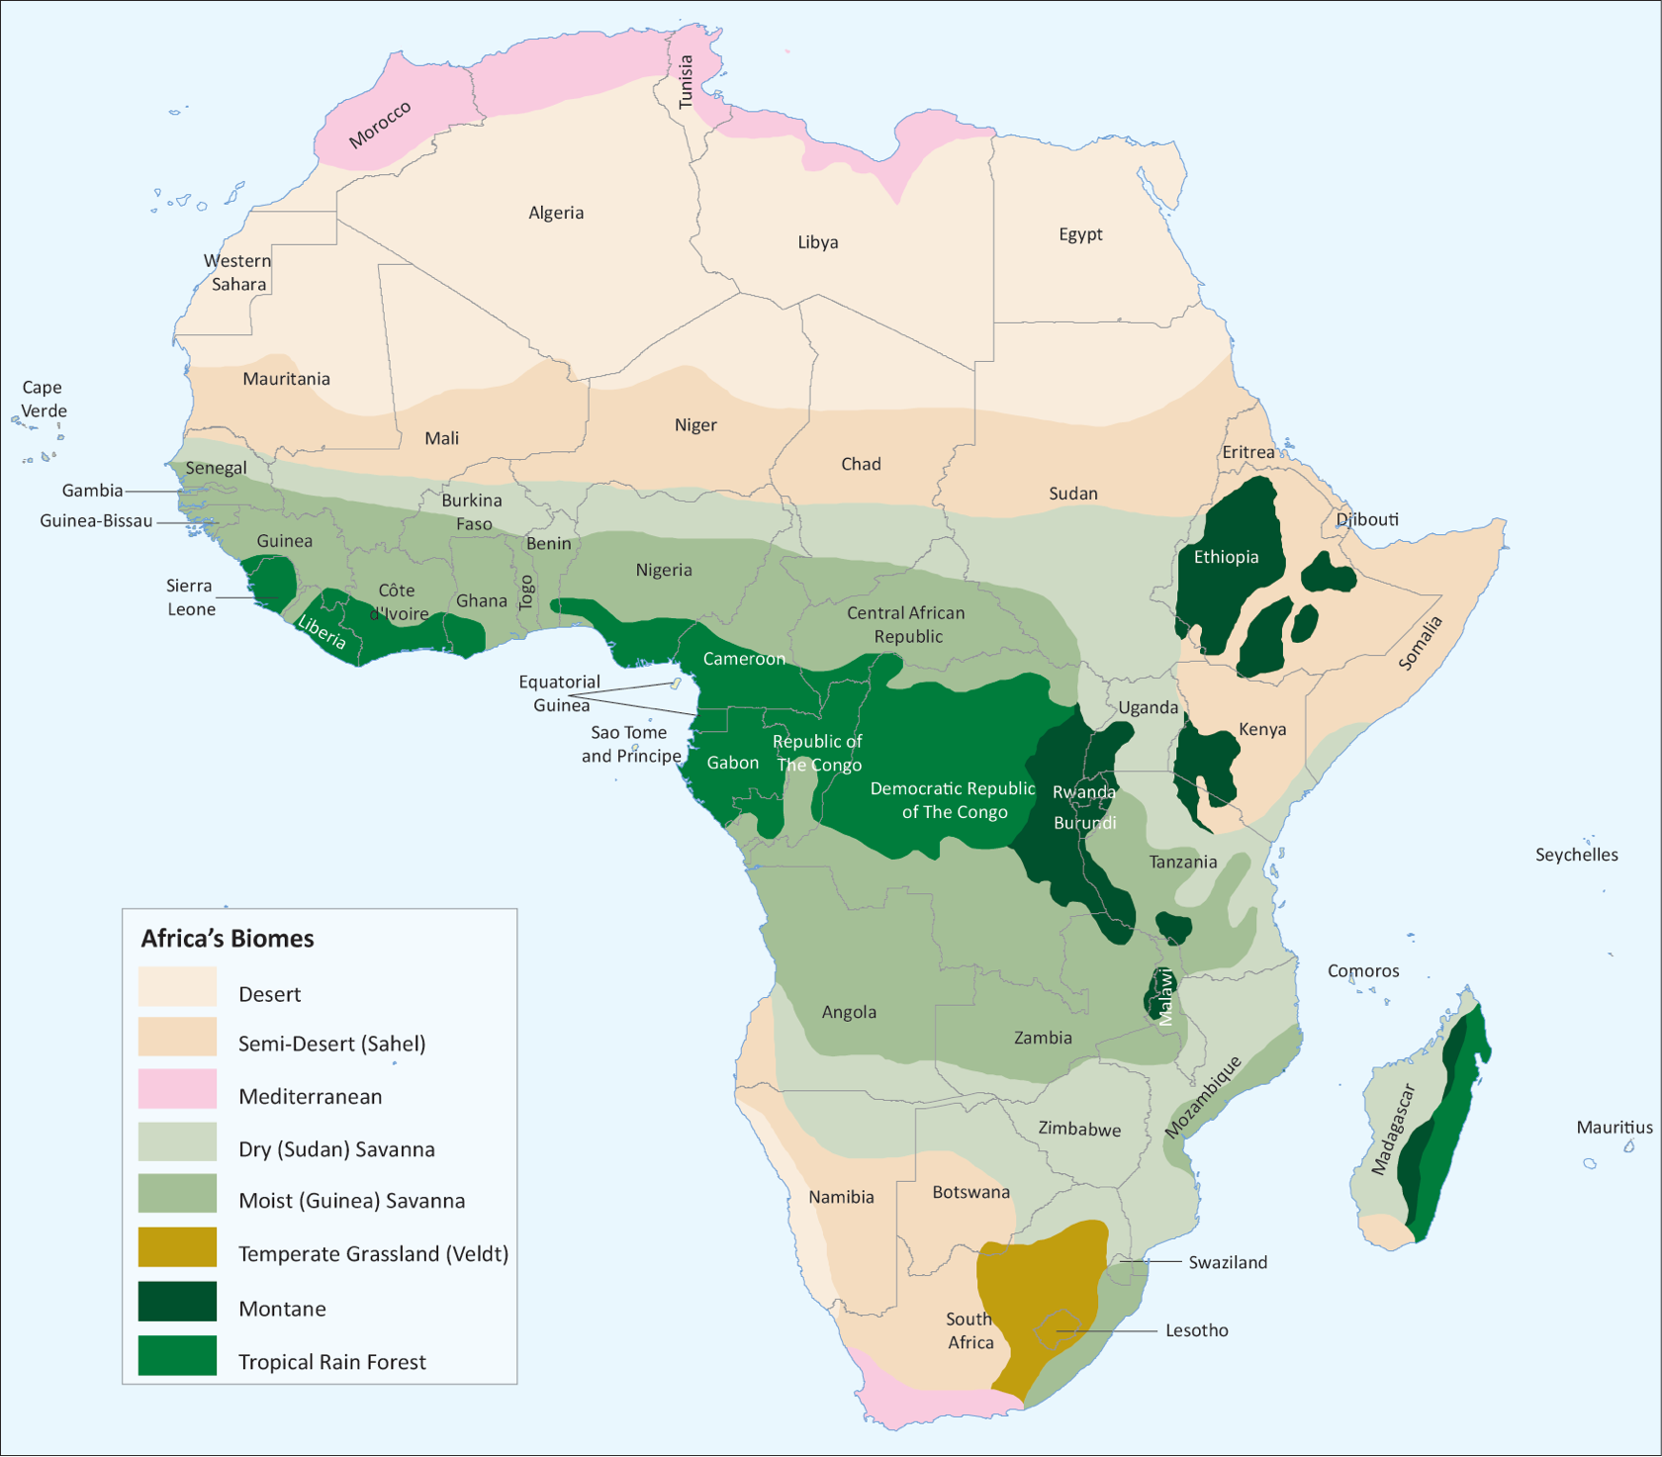
notice a pattern?

Slide 21
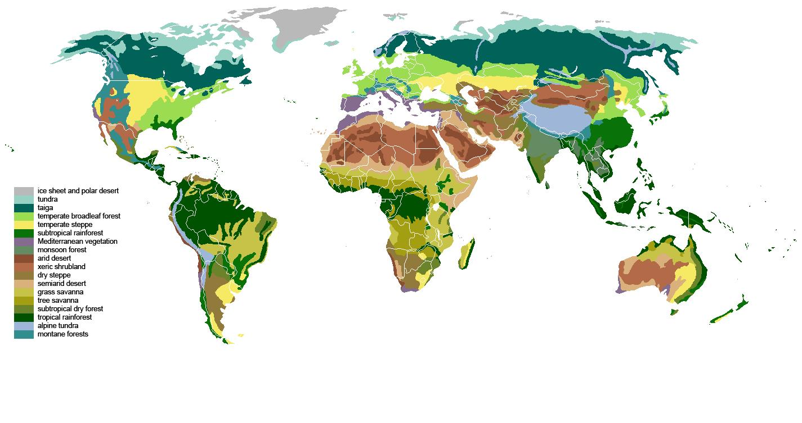
tundra
taiga
temperate forest
desert
tropical rainforest
savanna

Slide 22
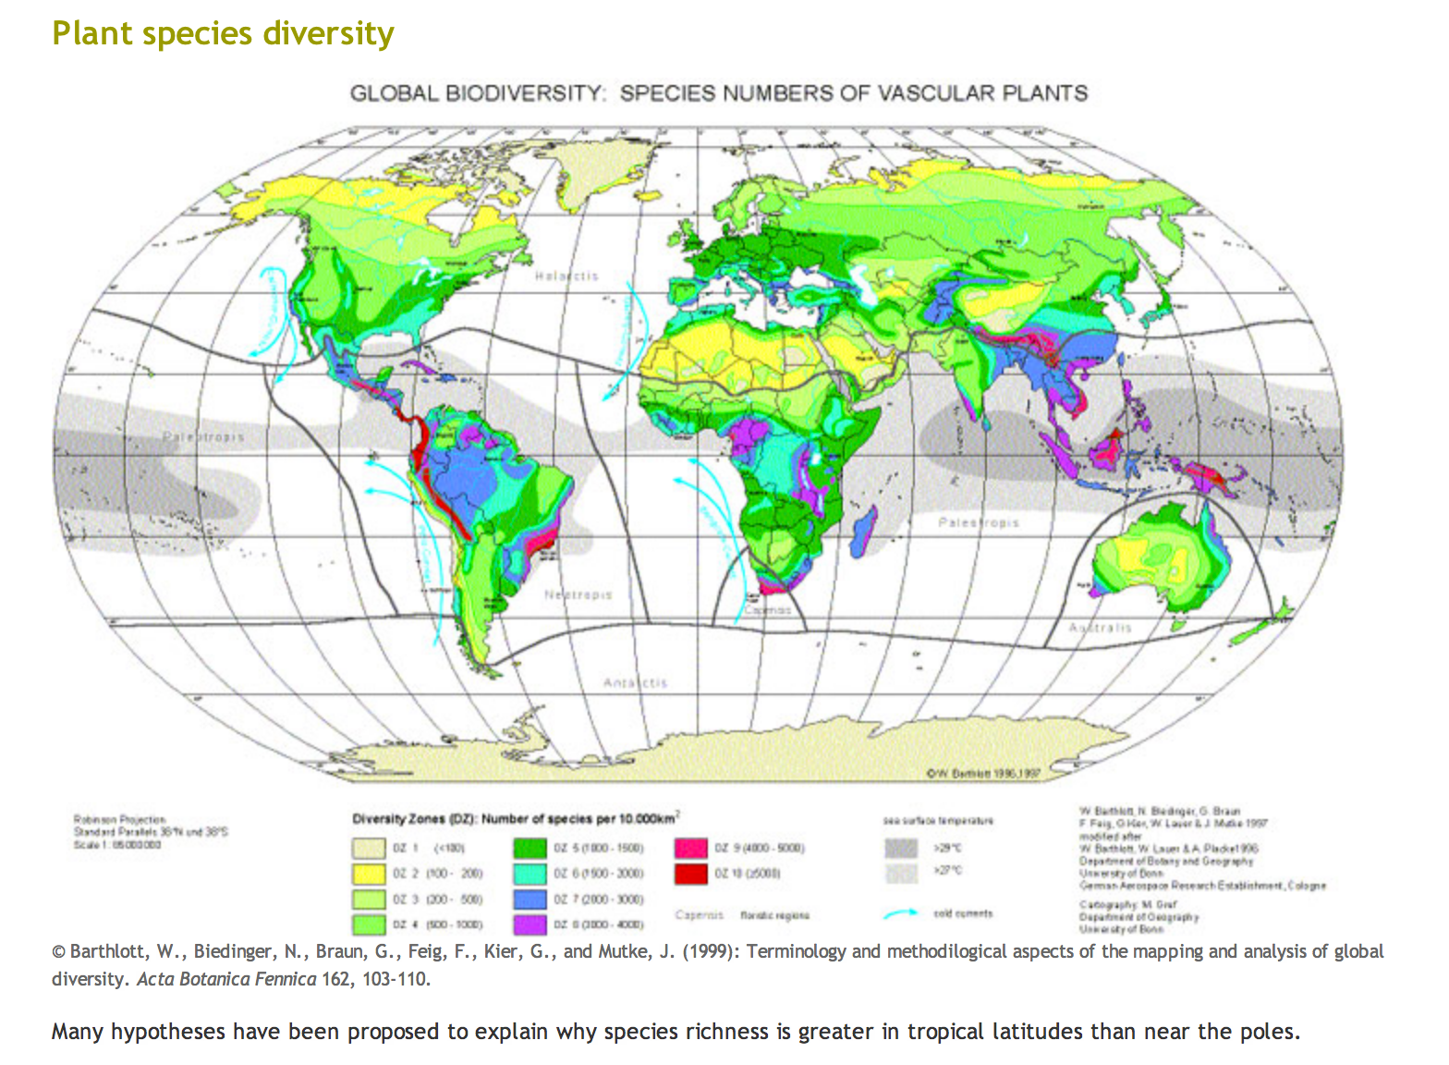

Slide 23
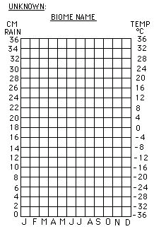
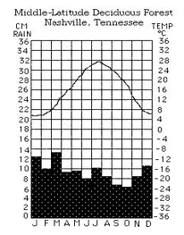
Climotograph- biome data at a glance
your turn...

