Slide 1
Designing experiments
How to collect the data you need

Slide 2
OUTLINE of topics
Avoid obvious problems with:
The question
Sampling
Variables
How to do sampling.
Principles of experimental design.

Slide 3
Data collection
Consider the following 3 research questions:
What is the average mercury content of swordfish in The Atlantic Ocean?
Over the last 5 years, what is the average time to degree for Duke undergrads?
Does a new drug reduce the number of deaths in patients with severe heart disease?
Each question has a specific target population.
Usually impossible to study the entire target population so sampling is used.

Slide 4
Anecdotal evidence
A man on the news got mercury poisoning from eating swordfish, so the average mercury concentration in swordfish must be dangerously high.
I met two students who took more than 7 years to graduate from Duke, so it must take longer to graduate at Duke than at many other colleges.
My friend’s dad had a heart attack and died after they gave him a new heart disease drug, so the drug must not work.
The evidence may well be true and verifiable but is not likely to represent the target population very well.

Slide 5
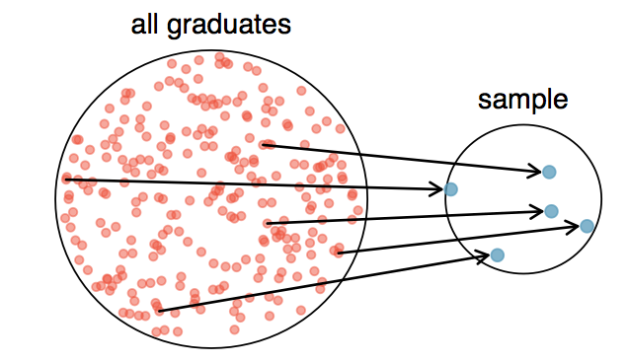
Sampling from a pop
Ex: How long for Duke students to graduate?
Random selection is vital.
How might this sample have been collected?

Slide 6
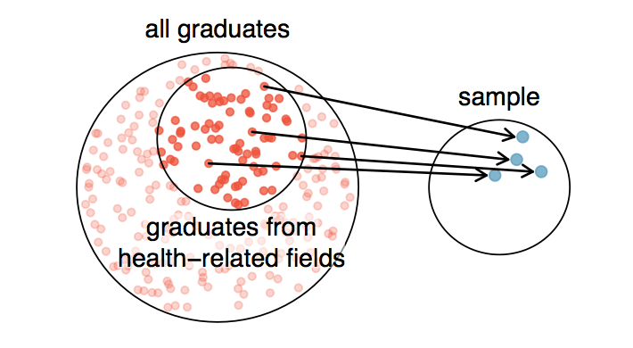
What happened here?
This is a convenience sample. Probably introduces bias into the sample.

Slide 7
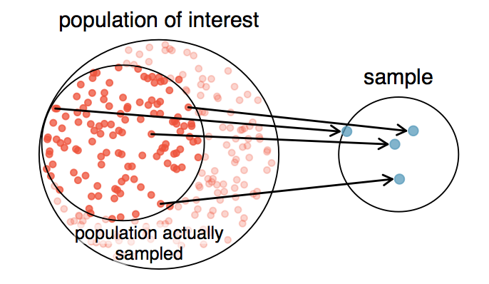
Other forms of bias
Non-response bias – sampling protocol may be random but introduce unintentional bias.
Most often seen in surveys
Surveys sent to random sample of population but only answered by a certain subset of pop.
*pause - Q: If 50% of the online reviews of a product are negative, do you think this means that 50% of buyers are dissatisfied?

Slide 8
Explanatory and response variables
Explanatory variable is thought to affect response variable
Causal relationship is NOT guaranteed. Labels are used to keep track of which variable might affect the other. There can be multiple explanatory variables.

Slide 9
Observational studies
Data is collected without interfering in how the data arises.
Ex: collect data from surveys, medical records or follow a cohort (group of similar individuals) over time.
Can demonstrate association NOT causation.
Ex: An observational study found that increased sunscreen usage was associated with increased skin cancer. True verifiable data but what does it mean?
*pause – What else might be going on?

Slide 10
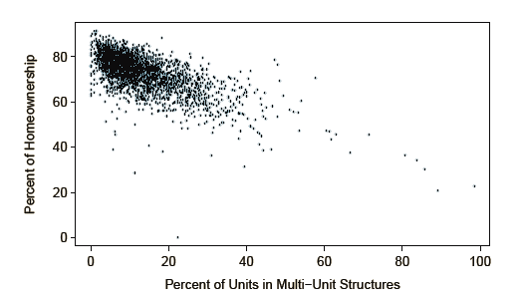
Confounding variables
A variable that is correlated with both explanatory and response variables.
Can you think of any confounding variables to explain this relationship?

Slide 11
How to get random samples
Almost all statistical methods are based on having random samples from a population.
3 types:
Simple random sampling
Stratified sampling
Cluster sampling

Slide 12
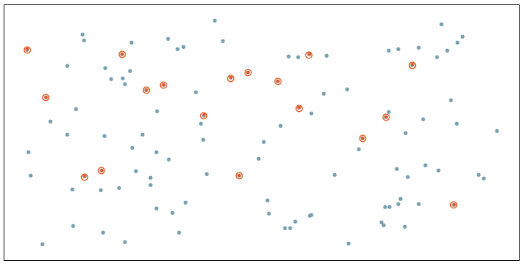
Simple random
Every member of the population has an equal chance of being sampled.
Knowing one member provides no info about other members.

Slide 13
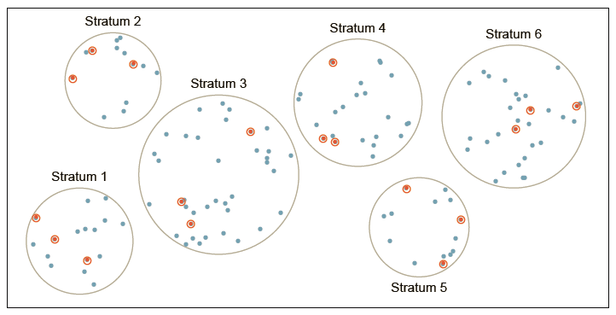
Stratified sampling
First create strata – similar cases are grouped together.
Strata often based on ordinal categorical variables.
Must sample from all strata equally.

Slide 14
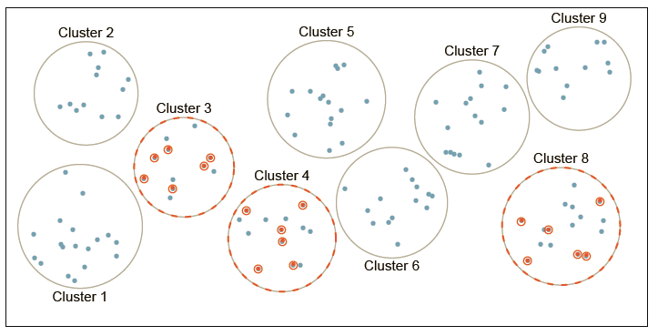
Clustered sampling
Cases placed into clusters. Some clusters randomly picked and then simple random sample taken from selected clusters.
Most useful when:
Inter-cluster variability is low.
Intra-cluster variability is high.

Slide 15
Principles of experimental design
Treatments are assigned to cases.
Contrast with observational studies.
Randomization is necessary to show a causal connection between variables.
4 principles:
Control
Randomization
Replication
Blocking

Slide 16
Controlling – minimize or eliminate any differences between groups.
Ex: drug is administered to experimental group in pill form.
How do you manage control?
Randomization – individuals randomly assigned to groups to minimize influence of other factors.
Some indivs might be more susceptible to disease due to diet. Mix indivs with high and low quality diets into groups.

Slide 17
Replication – more cases that are studied, the better we can understand how explanatory and response variables are related.
Large samples act as replicates.
Replicating entire experiment even better if $, etc allows.
Blocking – other variables (non explanatory) may influence response. Must control for this.
First group cases into blocks – indivs share characteristic in common.
Randomly assign members from each block to control and experimental groups.

Slide 18
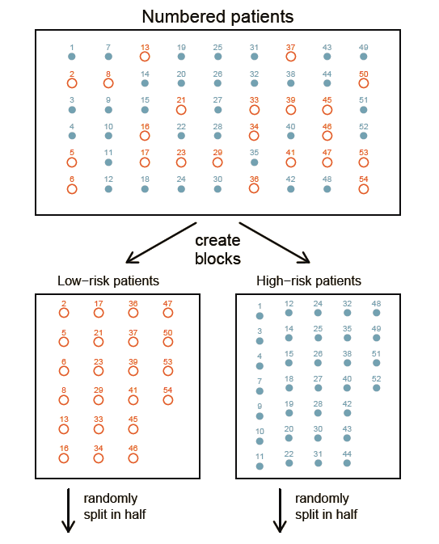

Slide 19
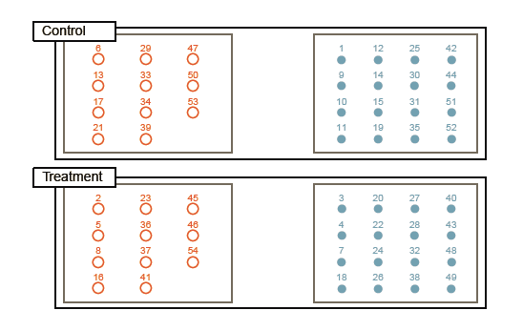
Is there any bias that might arise? Is there anything that has not been controlled?

Slide 20
Blind studies and placebos
From previous example:
If patients are aware of treatment vs. no treatment:
may lead to emotional effects that are hard to quantify
possibly influence response variable.
Make study blind – patients do not know whether they are receiving treatment or placebo.
Double blind – researchers also do not know who receives treatment until study has concluded.

